Slide 1
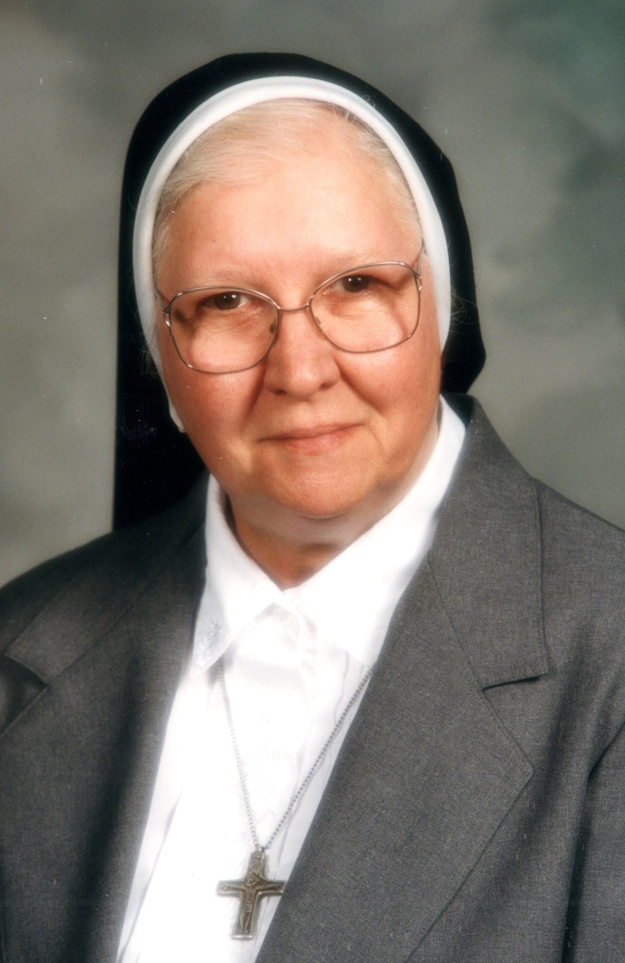
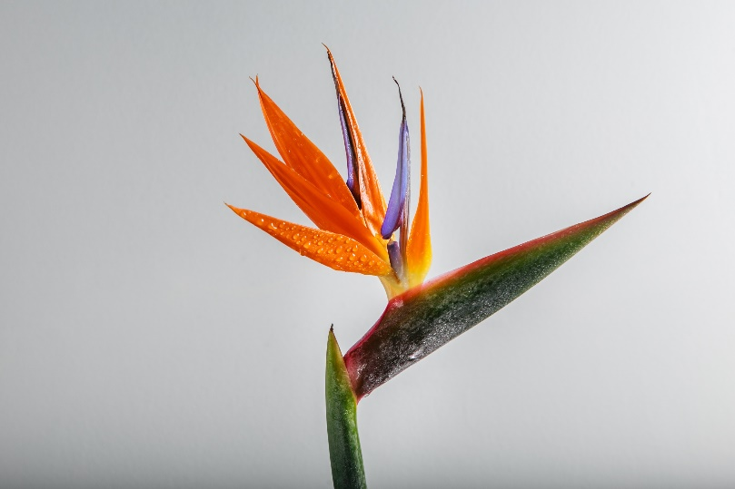

Slide 2
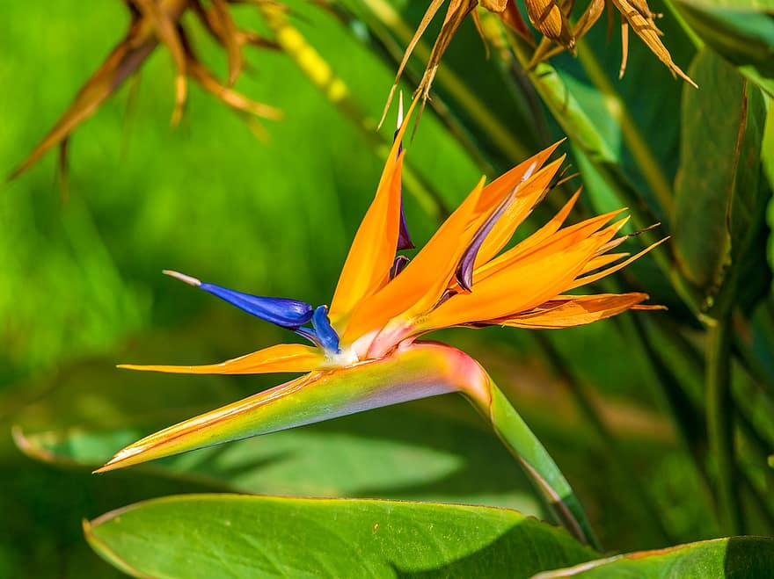
The Coressel Family
Sister Mary Danielle (Luella Mary Jean Coressel) was born in Defiance, Ohio, on June 1, 1928. She was the second child and first girl born to Daniel Joseph and Berna Elenor (Boff) Coressel.
Mary Jean
James
The family was eventually blessed with two more boys and five more girls!
Joyce
Richard
Eileen
David
Dolores
Carol
Lois

Slide 3
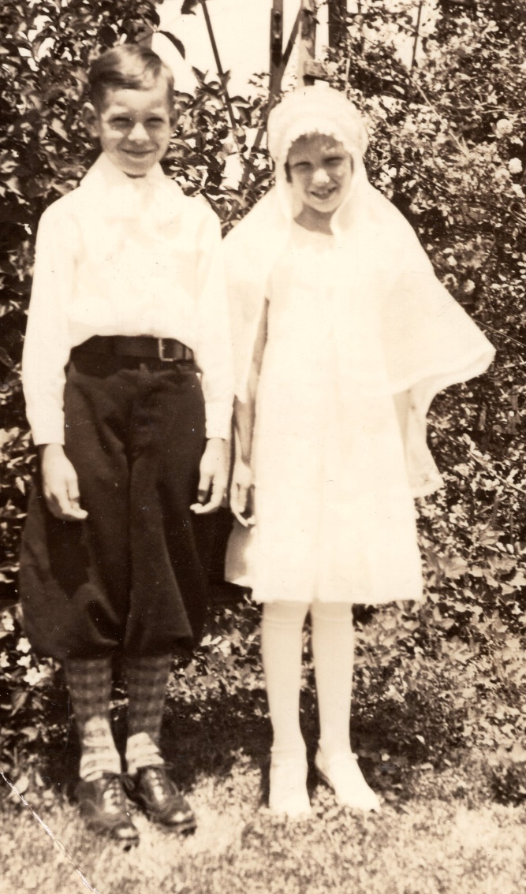
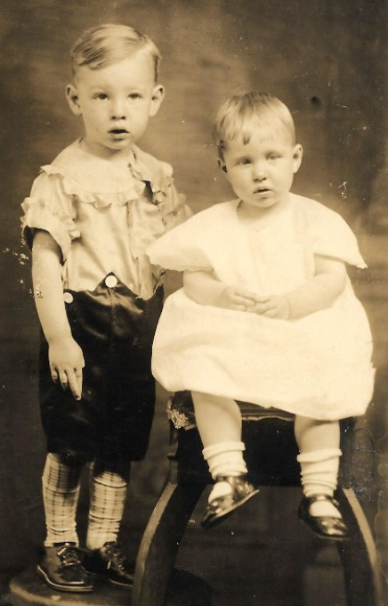
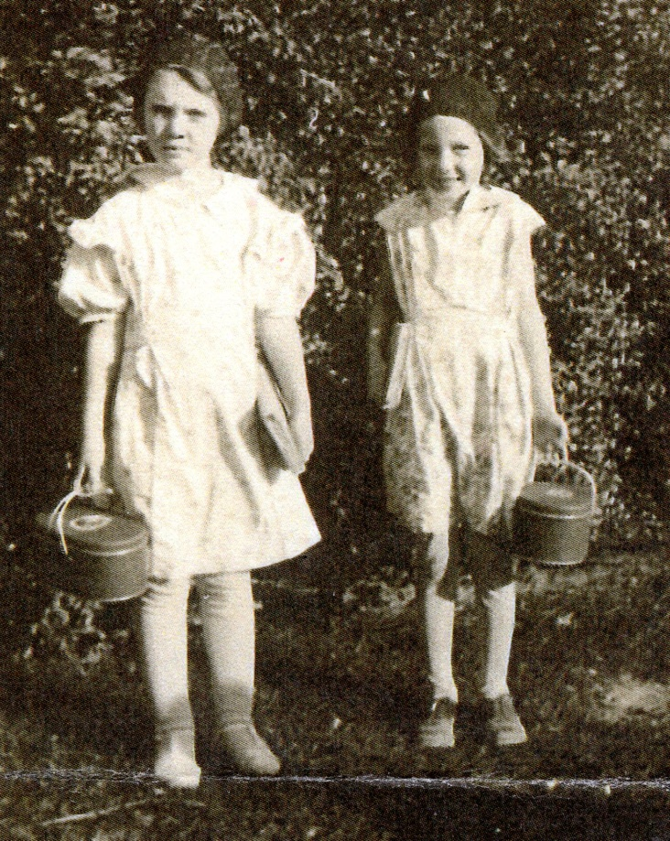
James and Mary Jean
Betty and Mary Jean
First Communion

Slide 4
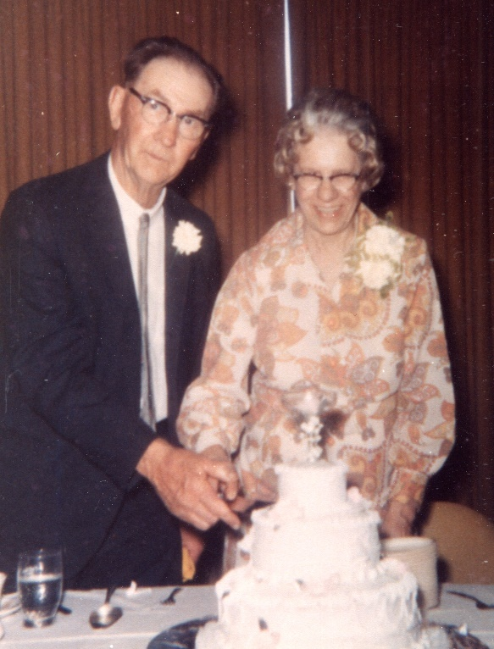
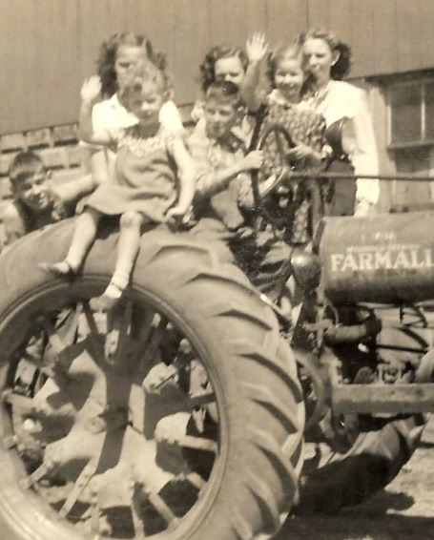
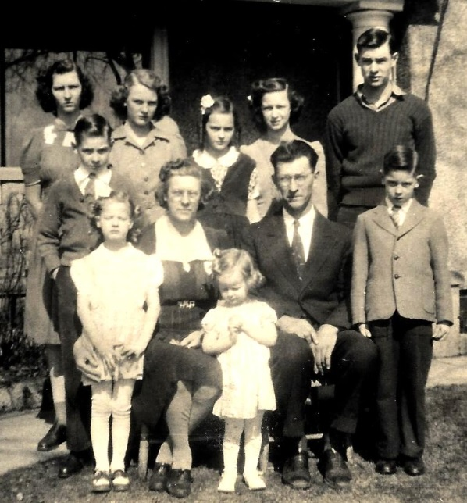
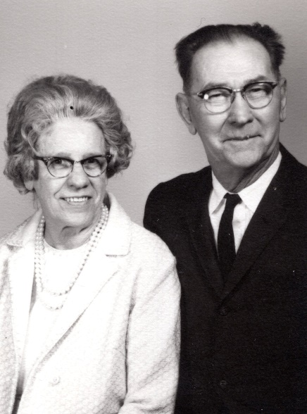
The Coressel Family
Mom and Dad
8 of 9 Children on the Tractor!

Slide 5
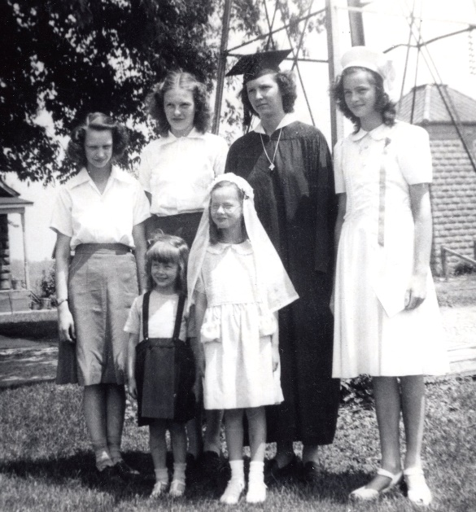
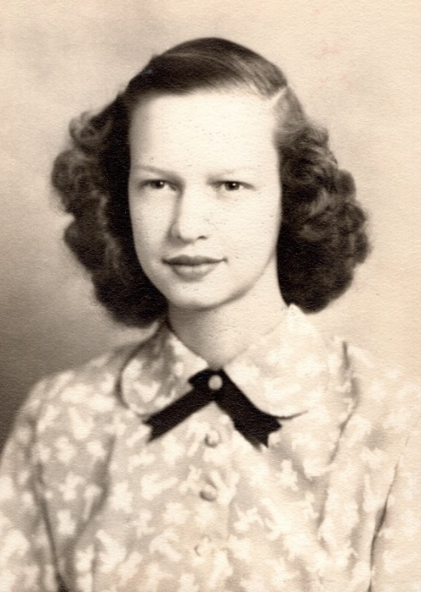
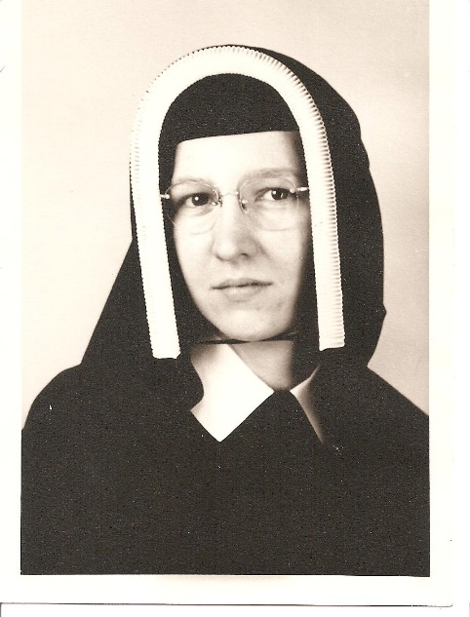
All 6 Girls!
Mary Jean
Postulant
Sister Mary Danielle
Invested August 10, 1948
Professed August 16, 1950

Slide 6
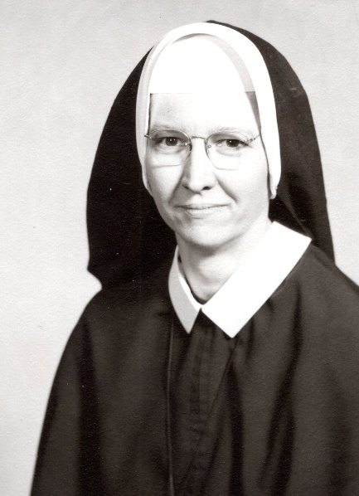
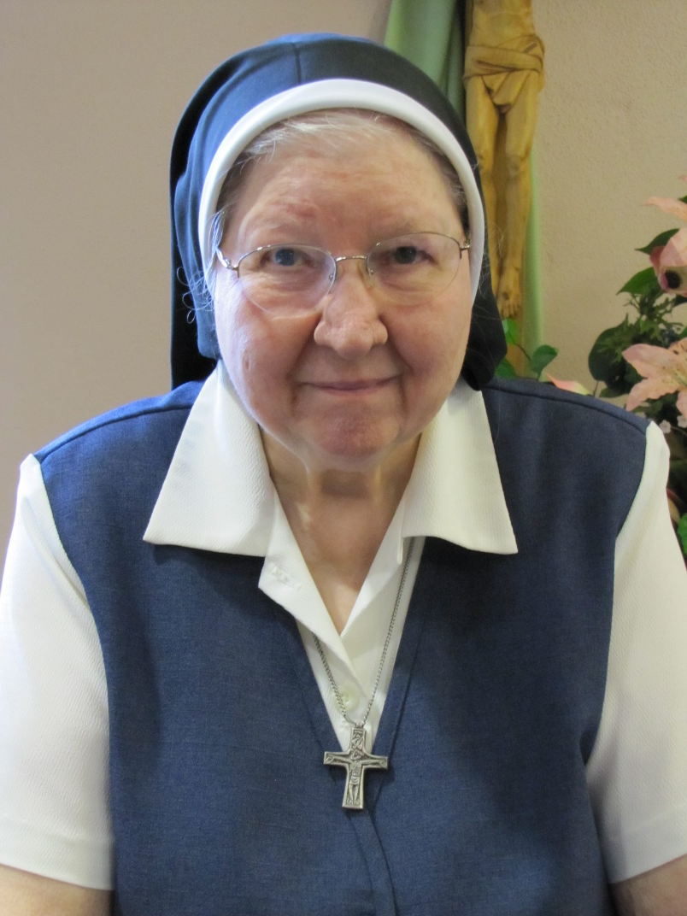
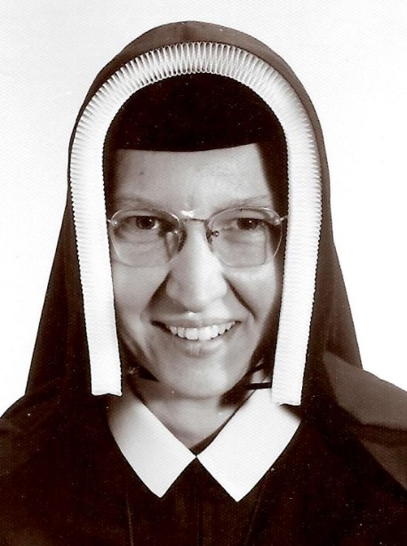
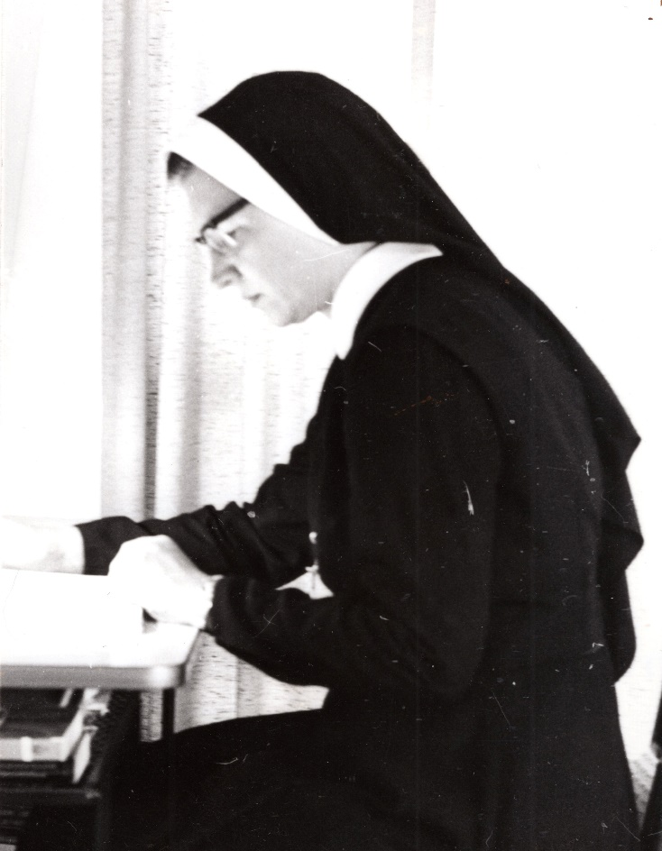
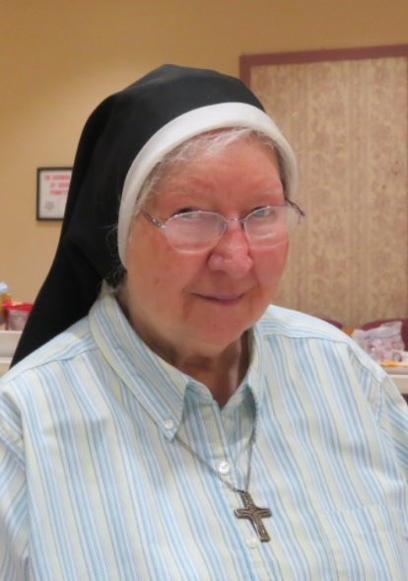
A Few Changes . . .

Slide 7
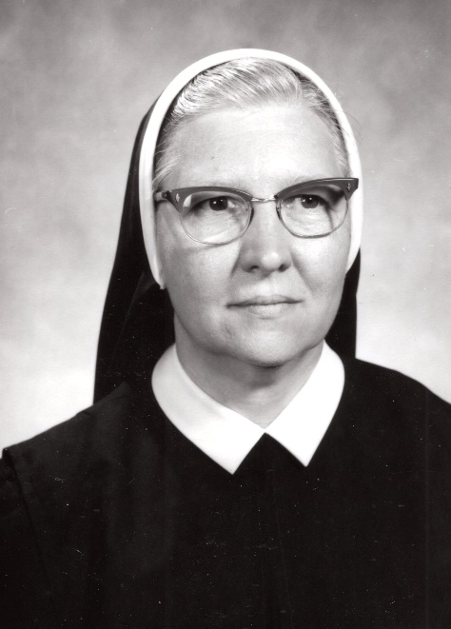
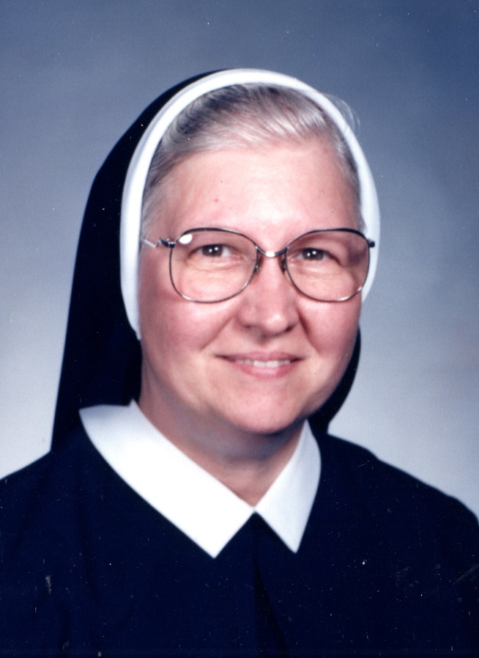
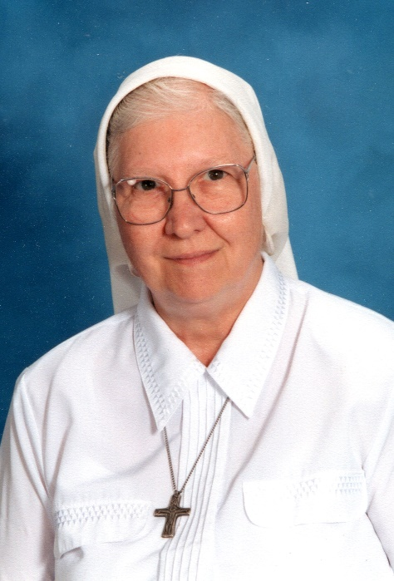
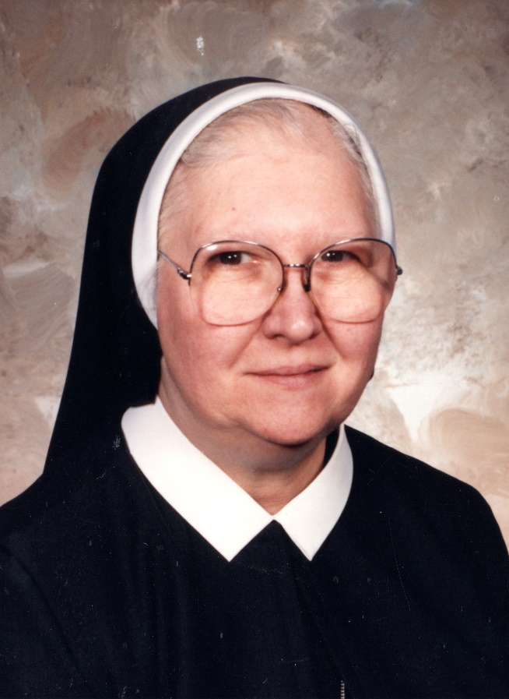
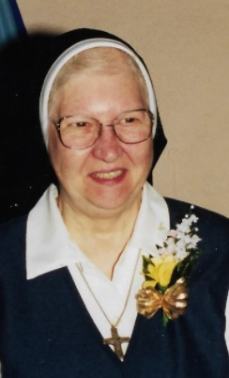
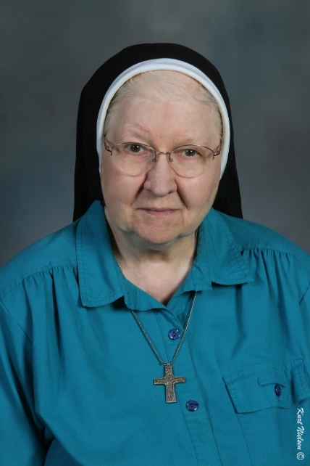
. . . Over the Years

Slide 8
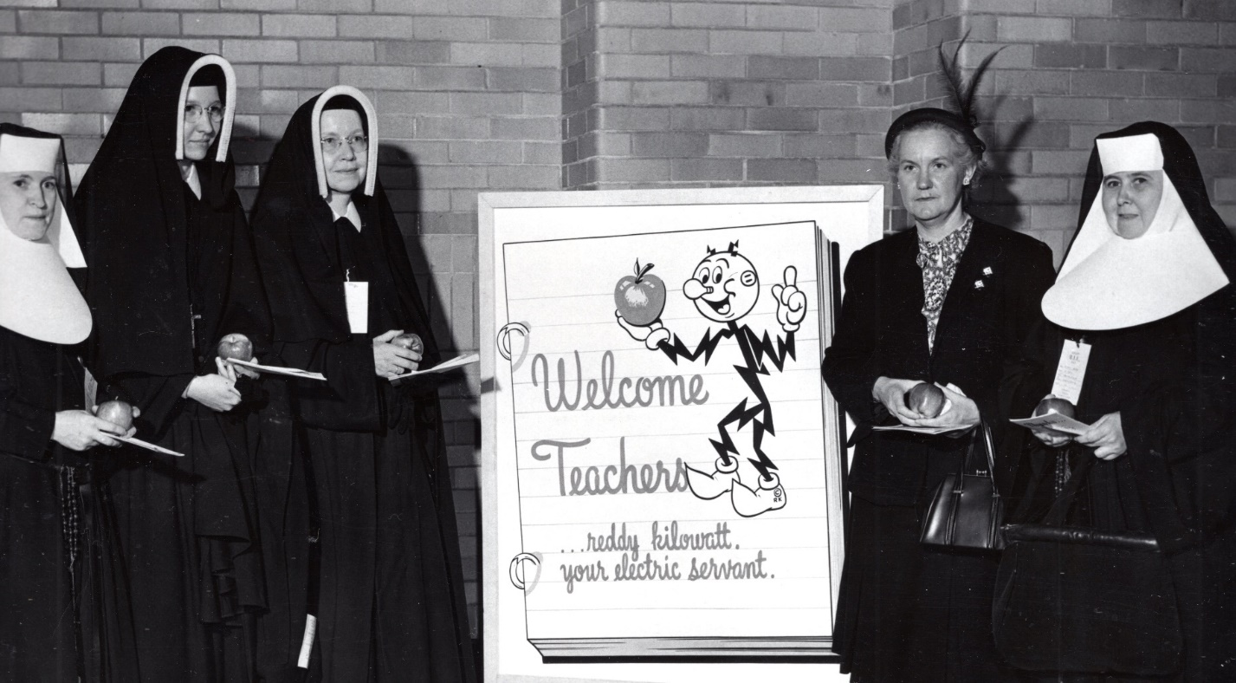
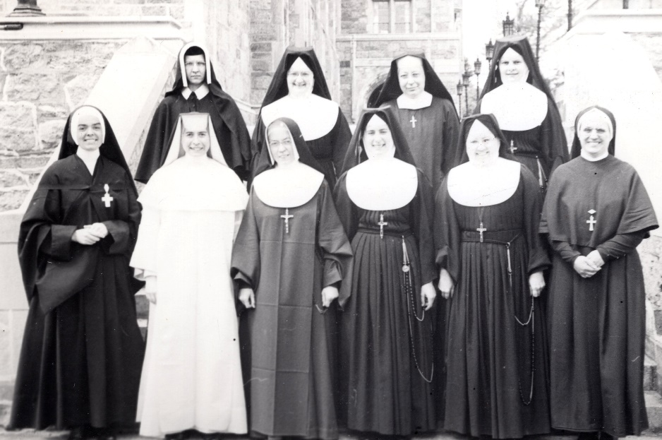
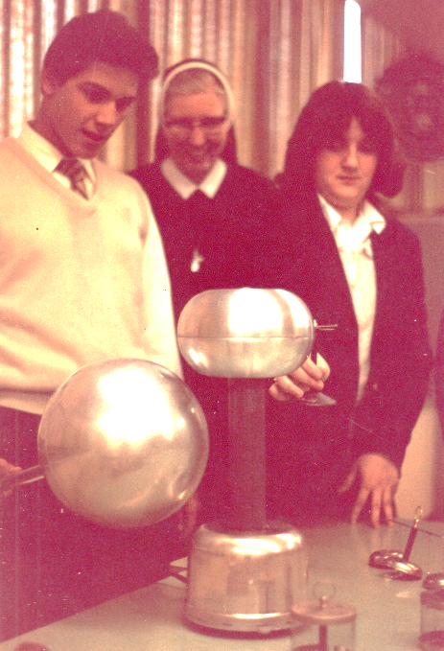
Remember BIE Days??
The Physics Class at Boston College
Physics Teacher

Slide 9
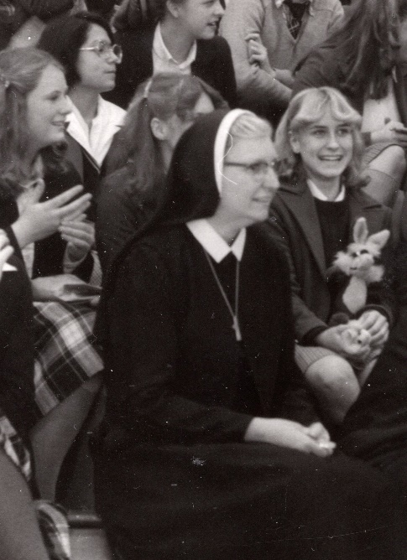
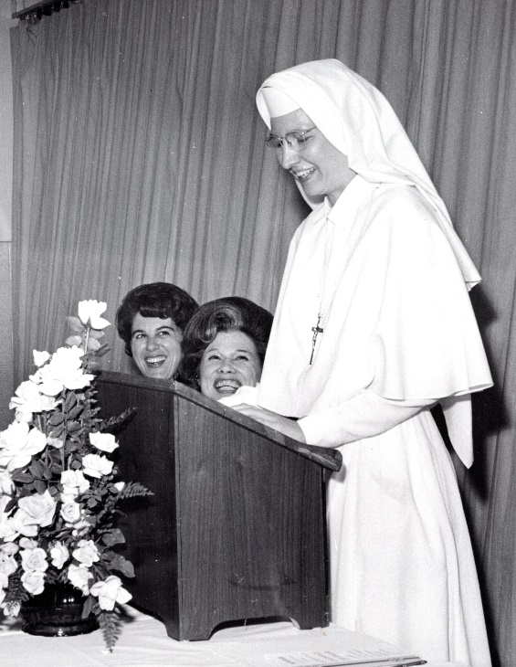
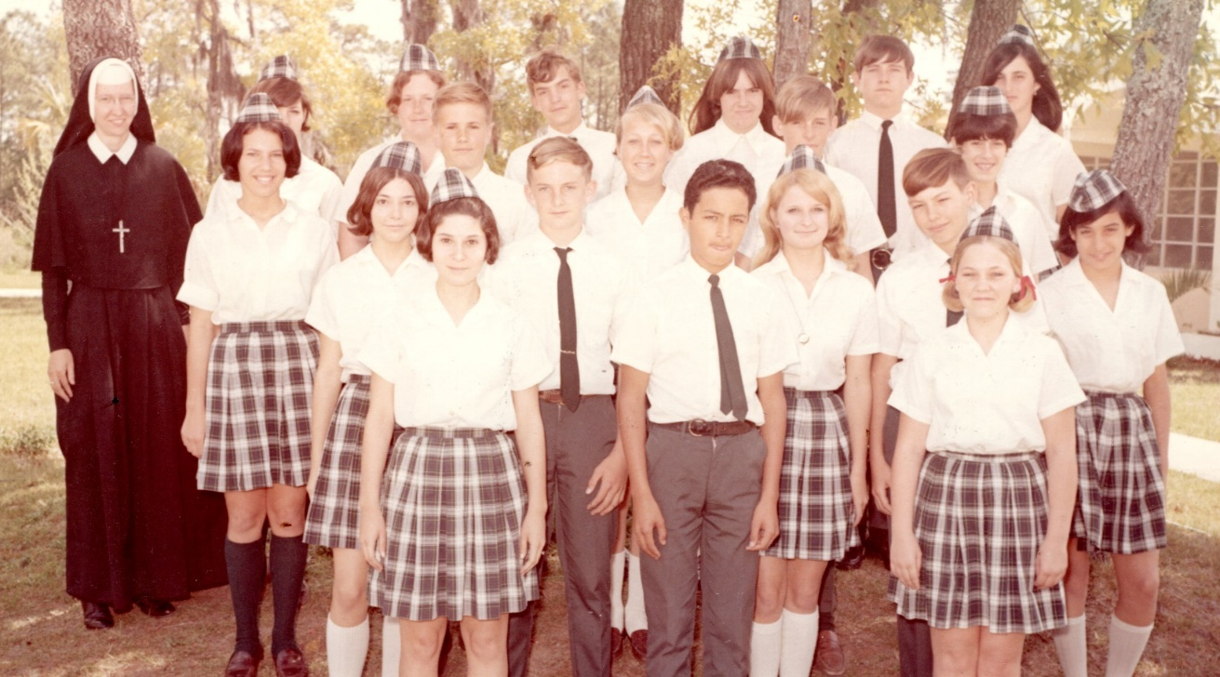
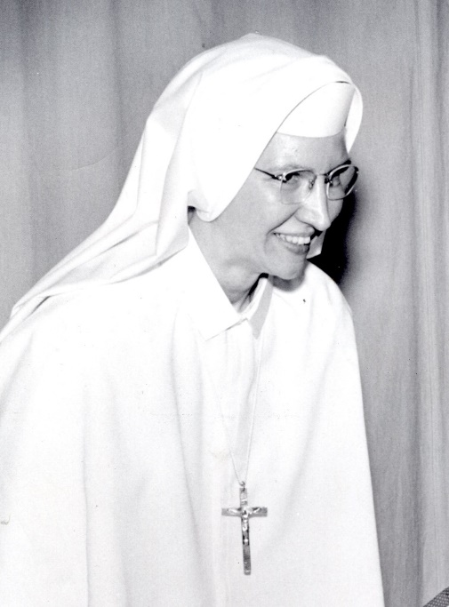
First Sister Principal of Blessed Trinity Academy, Jacksonville, FL . . .
. . . and 8th Grade Teacher!

Slide 10
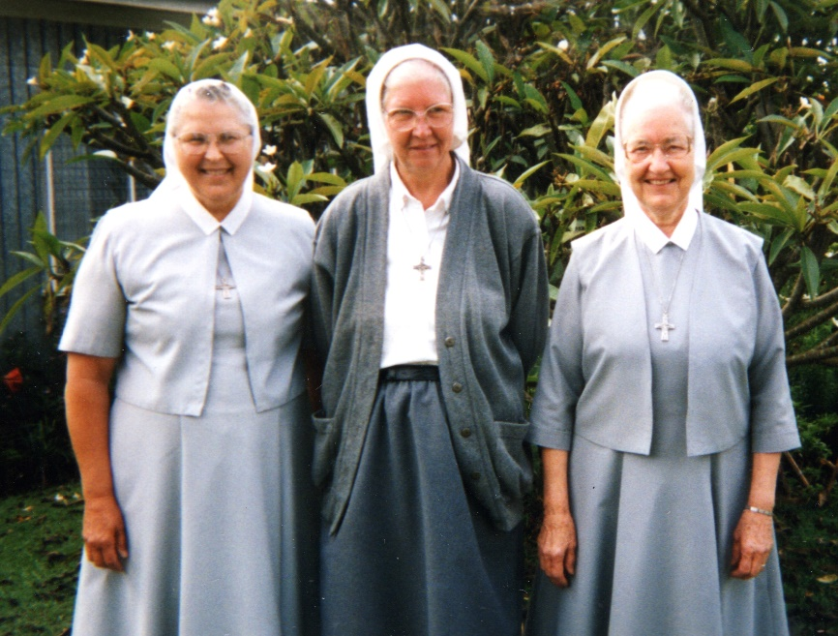
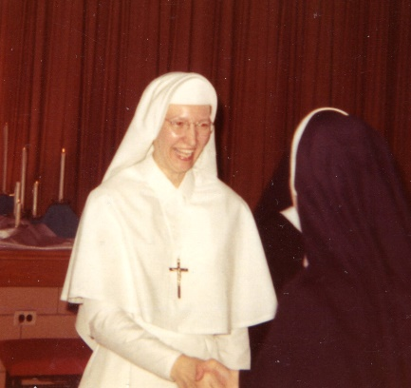
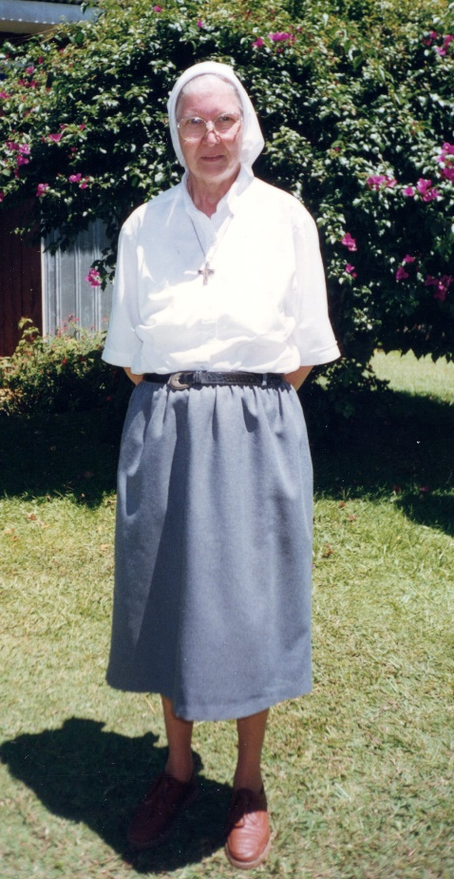
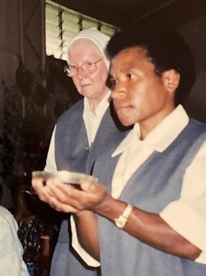
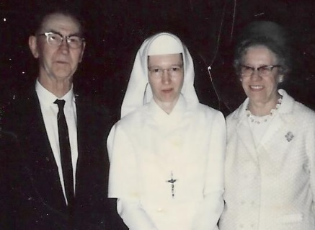
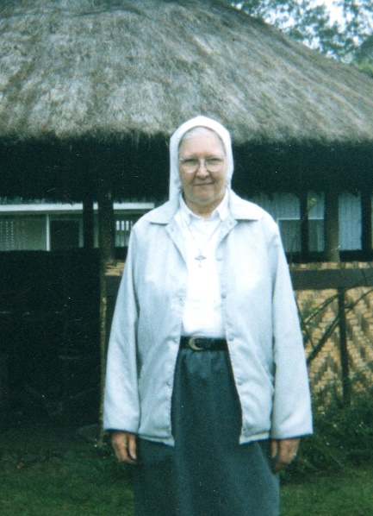
Her Beloved PNG!! Missioned and Sent!!

Slide 11
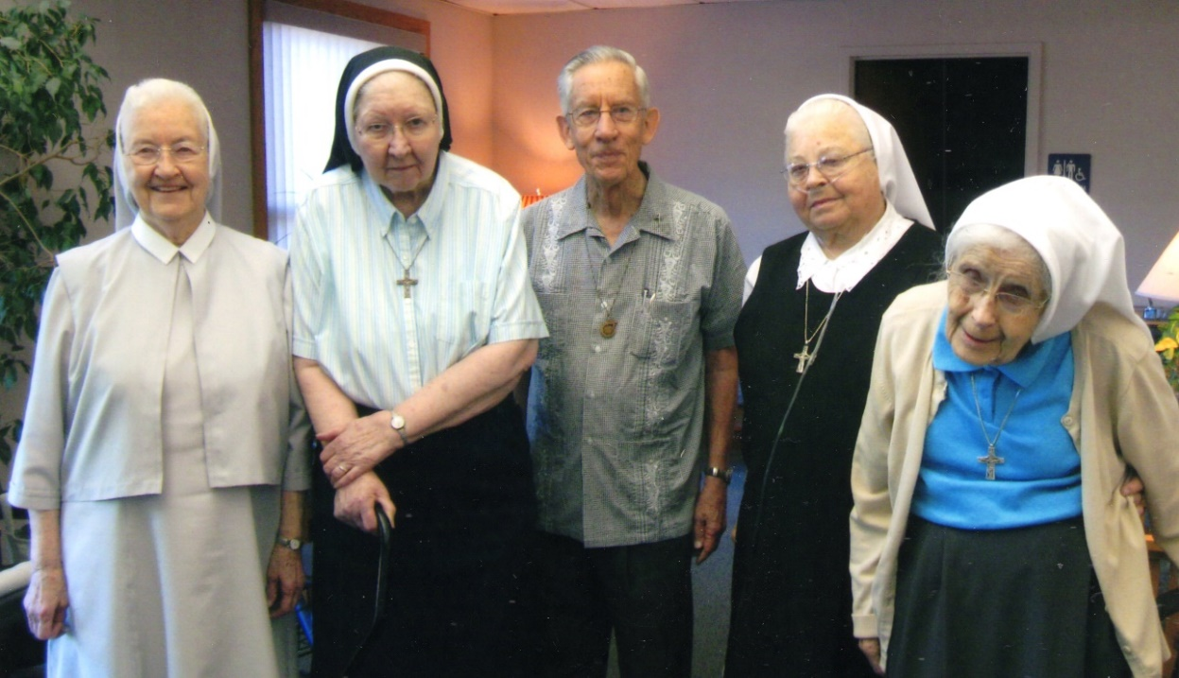
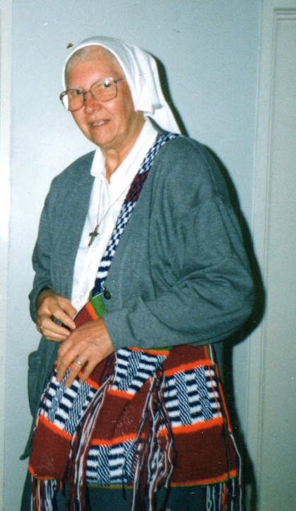
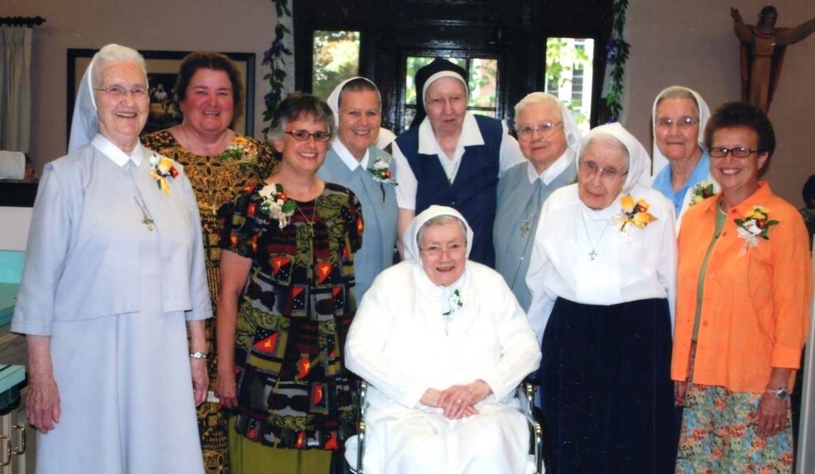
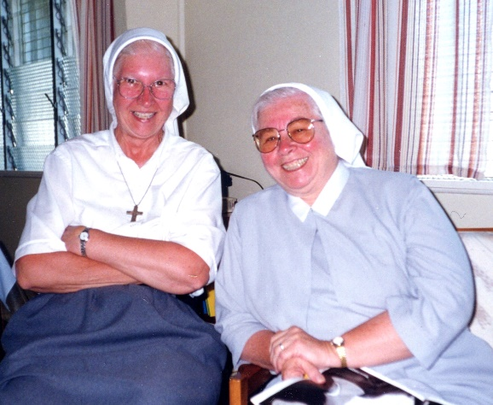
Shared Memories

Slide 12
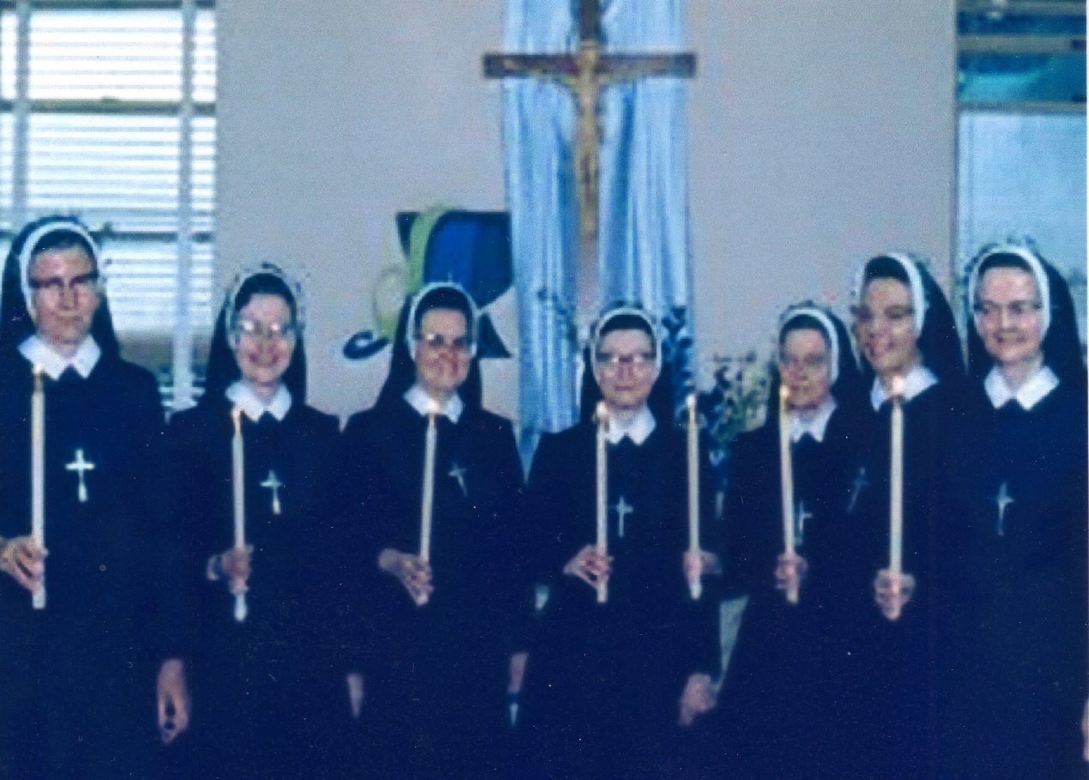
Jubilee Celebrations
Silver Jubilee
25 Years 1975
(PNG: Sister Mary Jean Francis, Sister Mary Marisa, Sister Mary Helen Rita)
Golden Jubilee
50 Years 2000

Slide 13
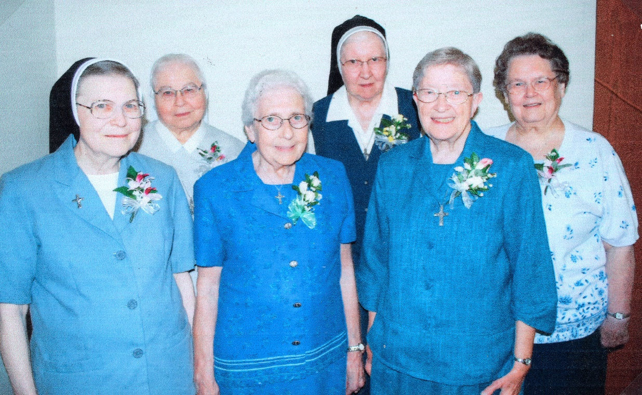
Jubilee Celebrations
Diamond Jubilee
60 Years 2010
Iron Jubilee
65 Years 2015

Slide 14
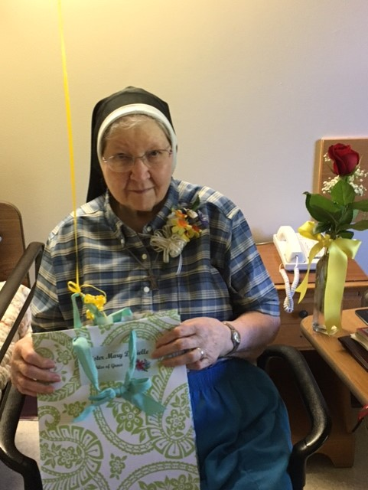
Jubilee Celebrations
Over the Years:
Elementary Teacher
High School Teacher
Missionary in Papua New Guinea Ministry of Prayer and Presence
Jubilee of Grace
70 Years 2020

Slide 15
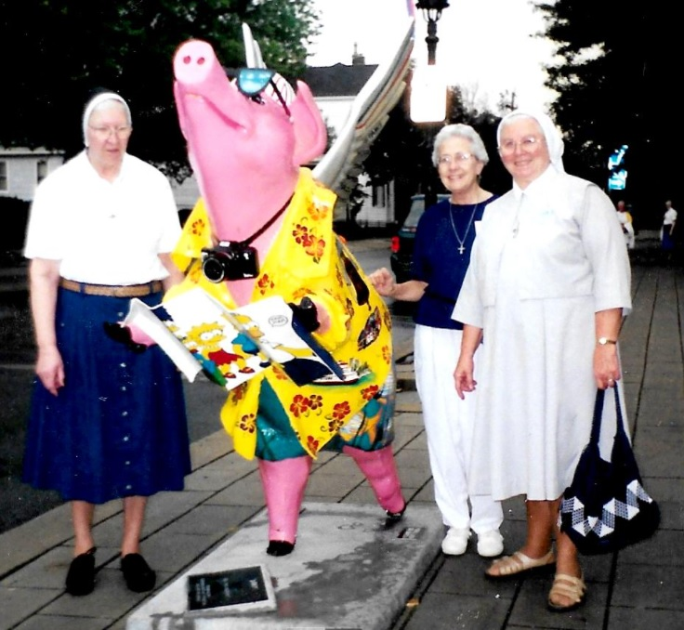
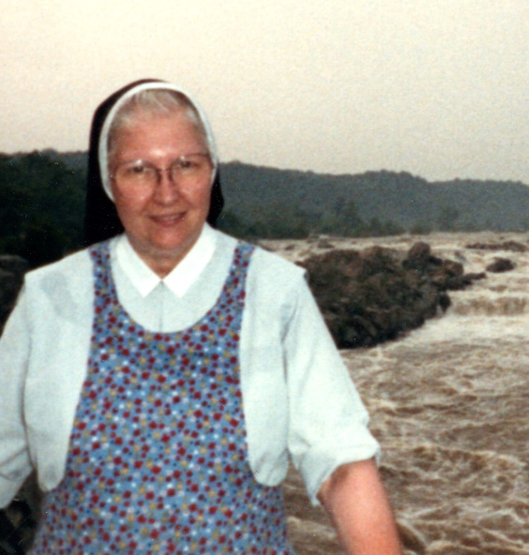
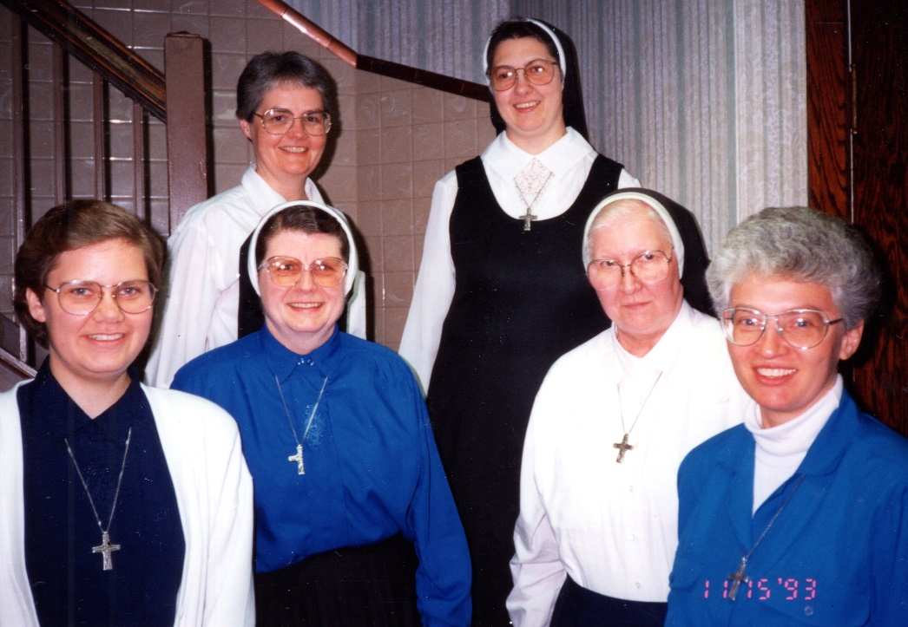
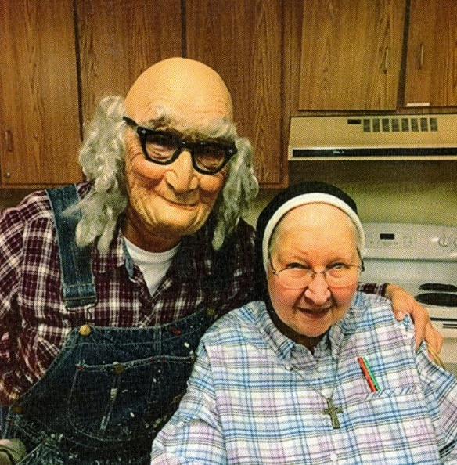
In Virginia
In Wheaton
On a Jubilee Trip
At Halloween

Slide 16
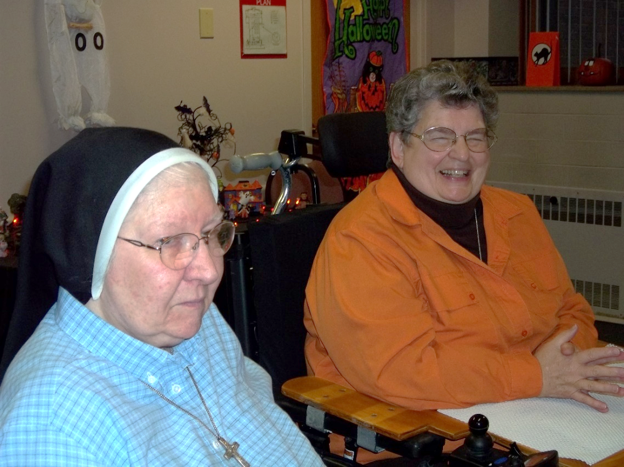
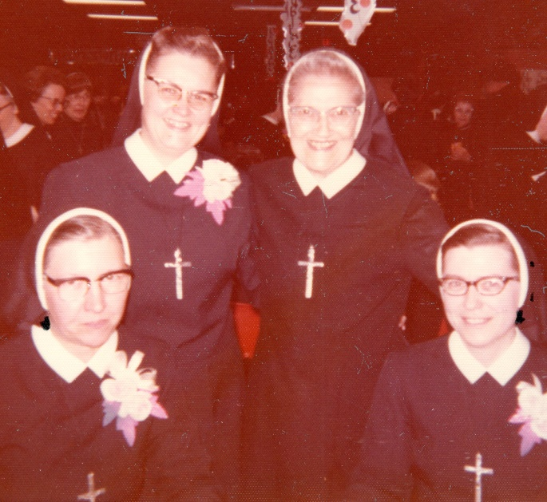
Community Gatherings and Celebrations
Cheered her Favorite Teams
Villanova and Gonzaga
Everything Chicago
Followed March Madness

Slide 17
At Notre Dame Academy
Community Days With her Sisters

Slide 18
Gatherings and Celebrations
With Friends and Family

Slide 20
Picnic at The Gardens
Sharing Gifts at the Ursuline Center -- Christmas From Carmel Indiana

Slide 21
Always Ready for Some Fun!
Loved to Read Mysteries
Master at Sudoku
iPad Puzzles
Brain Teasers

Slide 22
Sister’s Prayer Partners

Slide 23
One heart One hope One mission
Special Roman Visitors at The Gardens!

Slide 24
Sister Mary Danielle
May you REST in Him Whom you love
May we WALK as you have taught

