Slide 1
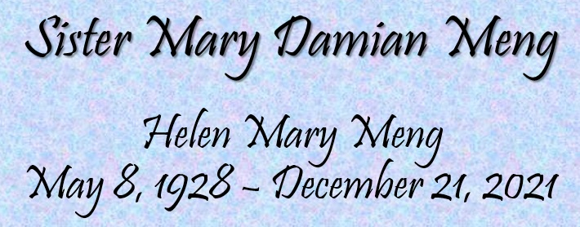

Slide 2
Thomas Merton, The Victory

Slide 3
Helen Mary Meng (1928) was the first child born to Louis Joseph Meng and Carolina Margaret (Heinsohn) Meng
She was joined the next year by her brother James Louis Meng (1929) and three years later by another brother Robert Franklin Meng (1932)
Helen and her brothers grew up in Genoa, Ohio,
a small community south of Toledo

Slide 4
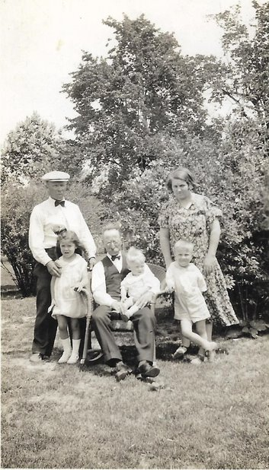
1929
Helen
James
Robert
1933

Slide 5
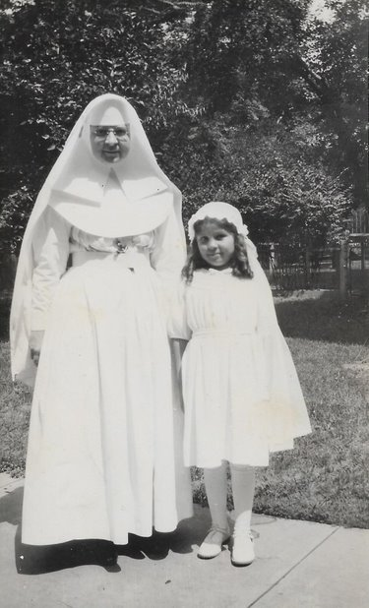
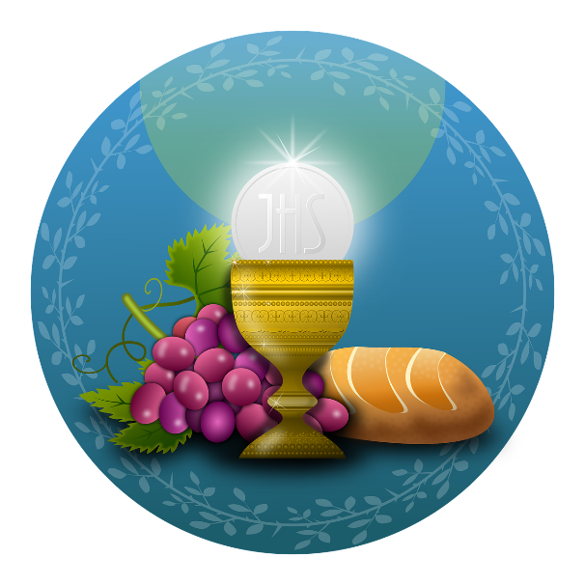
Helen Mary on the day of her First Holy Communion Pictured here with her Aunt
Sister Loretta, RSM
the younger sister of her father
(Anna Loretta Meng 1900-1993)

Slide 6
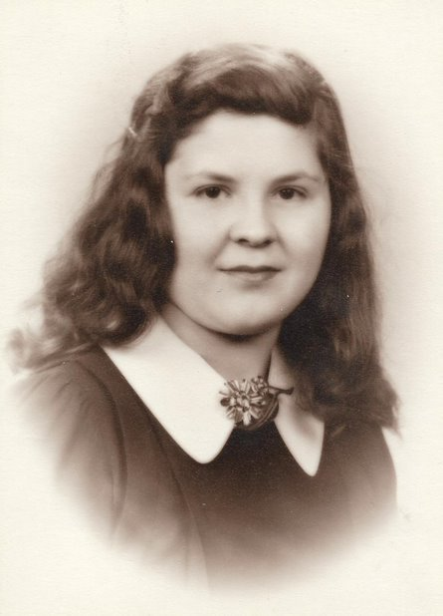
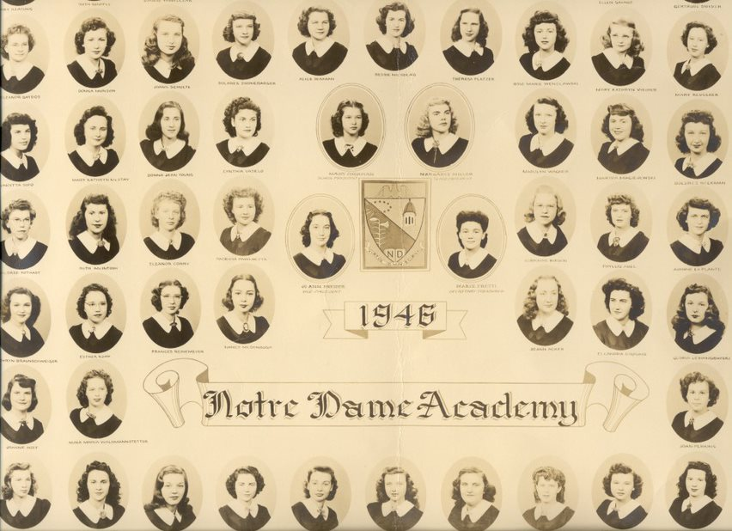
Helen Mary attended Notre Dame Academy in Toledo, Ohio, graduating in 1946

Slide 7
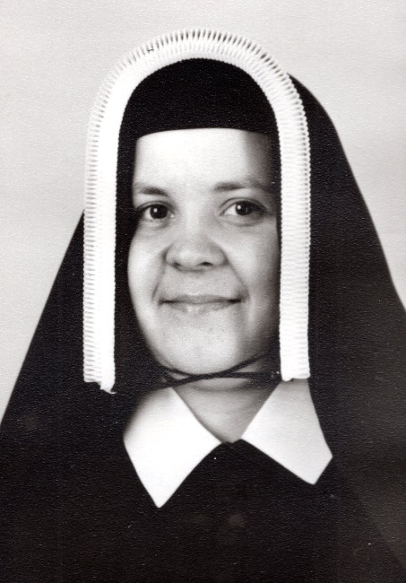
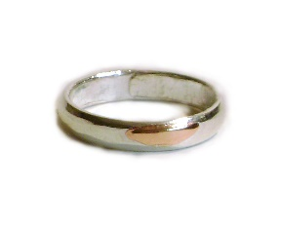
Helen Mary was invested on August 11th, 1947, receiving the name Sister Mary Damian
Sister Mary Damian made her
First Profession on August 16th, 1949 and
her Perpetual Profession on August 15th, 1954

Slide 8
She began her teaching career already as a Novice, teaching grades 2 and 3 at St. Michael’s School in Toledo, Ohio (1948)
Over the next 20 years Sister Mary Damian served
as teacher in various Diocesan schools ministering to grades 1-5 often with 2 or 3 grades in her classroom

Slide 9
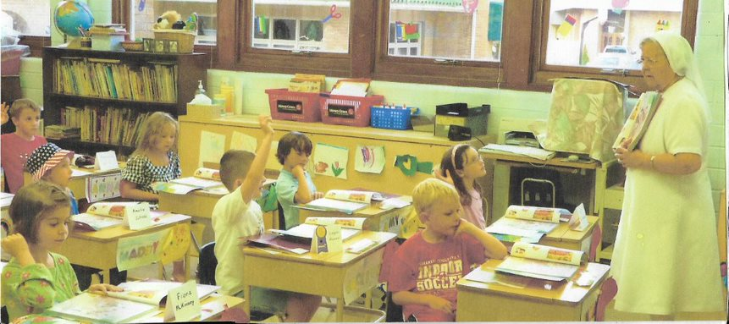
Sister also served as the Principal at St. Michael’s
in Defiance while teaching Grades 1-4!
In many of these schools Sister also taught
CCD classes
It was in one of these schools that the famous
“The Elephants Are Coming” story took shape!

Slide 10
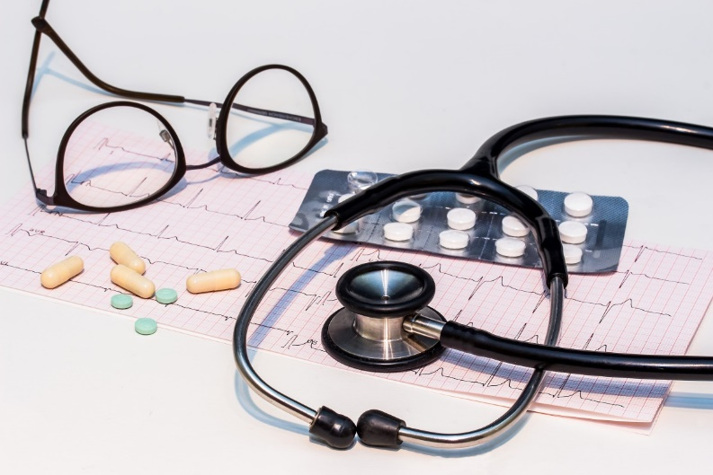
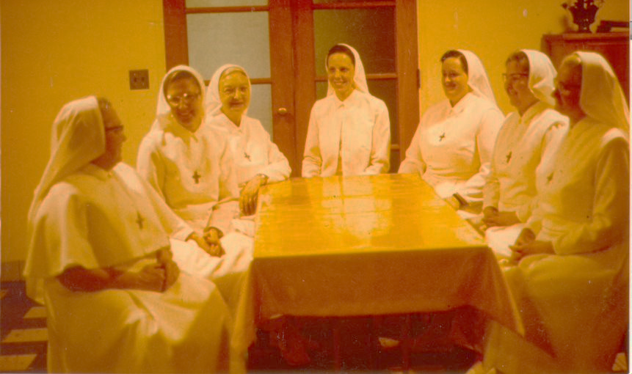
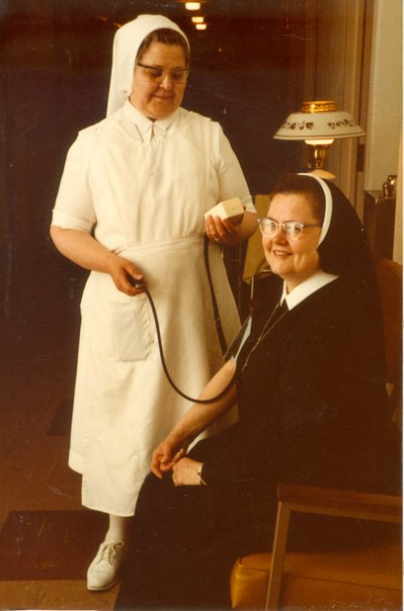
In 1969 Sister Mary Damian attended the
Northwestern Ohio Practical Nurse Training Center
and earned her LPN license
From 1970 to 1991 Sister served in our
SND Infirmary on Secor Road. During this time she twice ministered in the
California Health Care Center

Slide 11
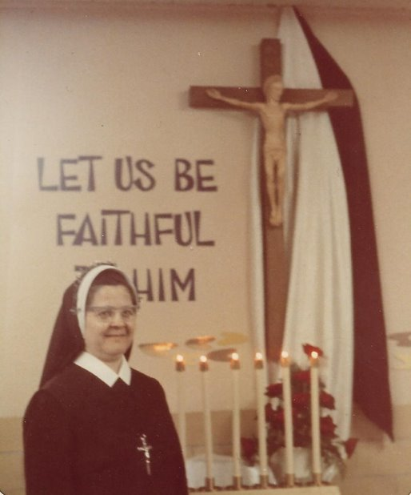
1974

Slide 12
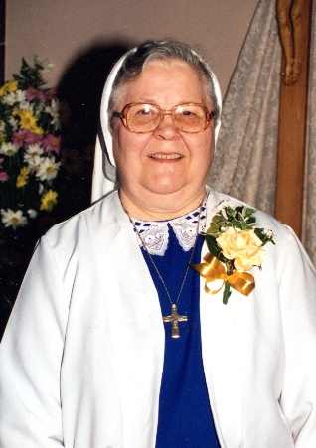
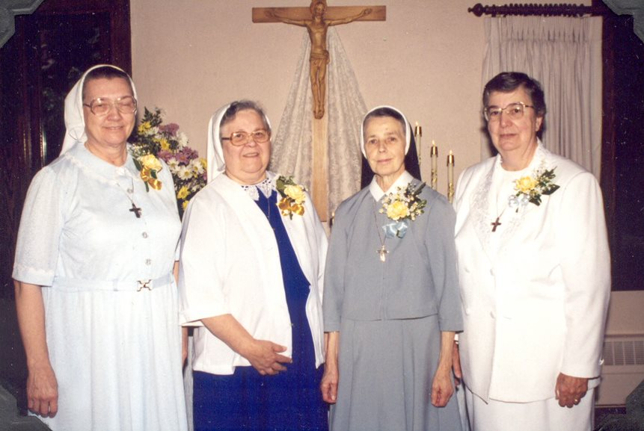
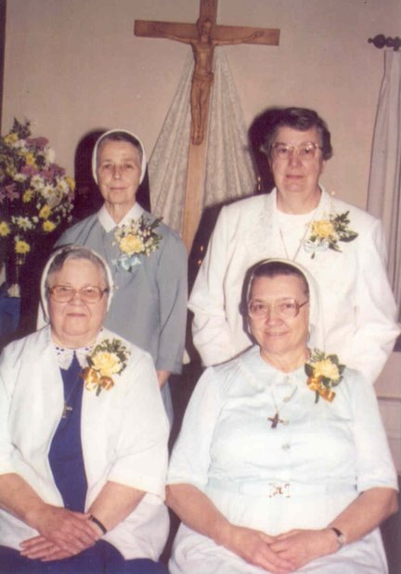
1999

Slide 13
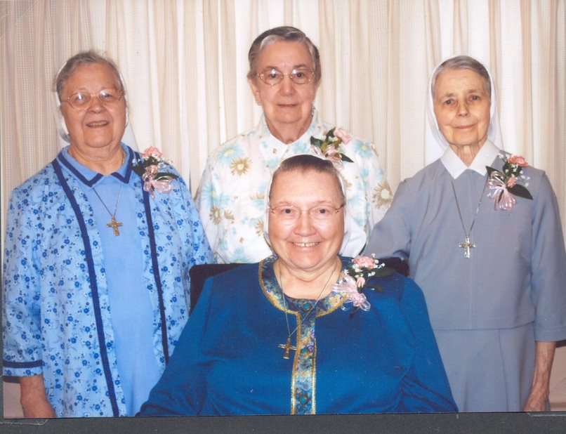
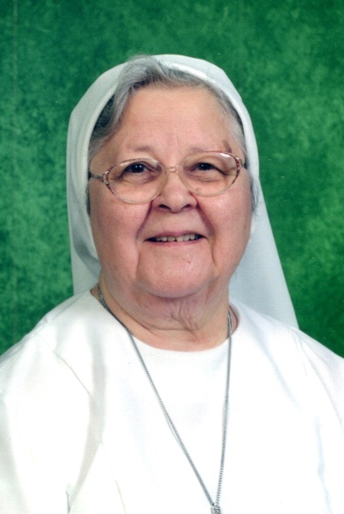
2009

Slide 14
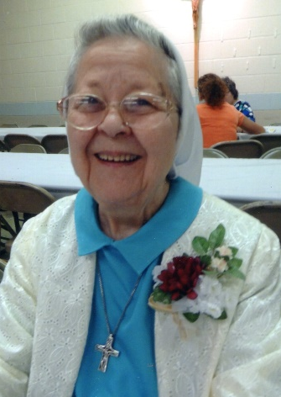
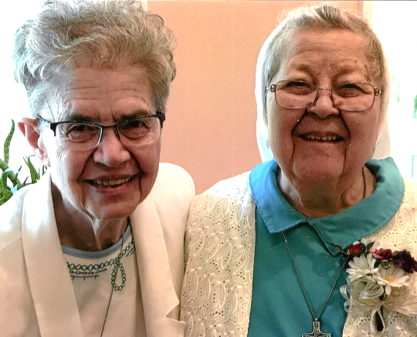
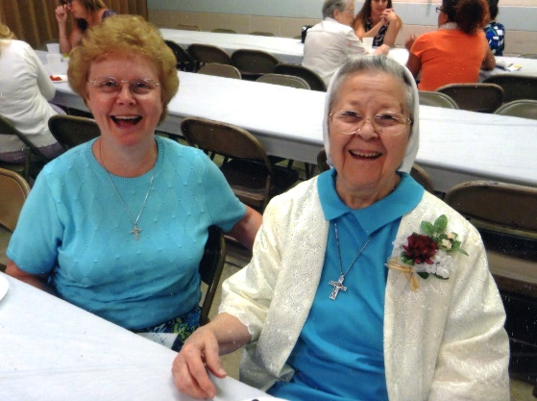
2014

Slide 15
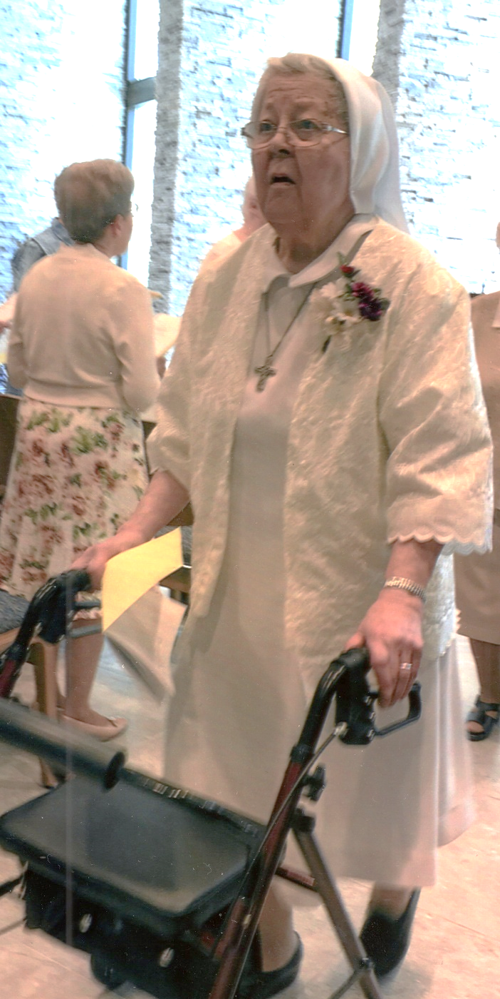
2019

Slide 16
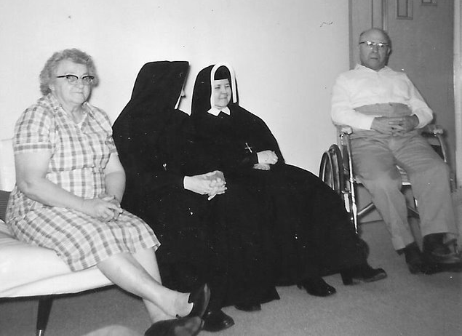
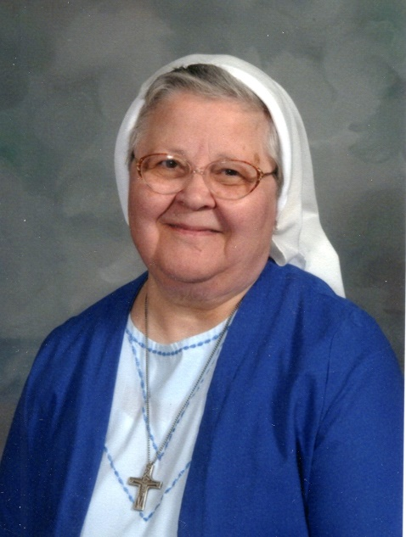
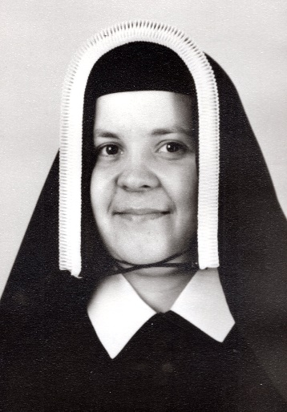
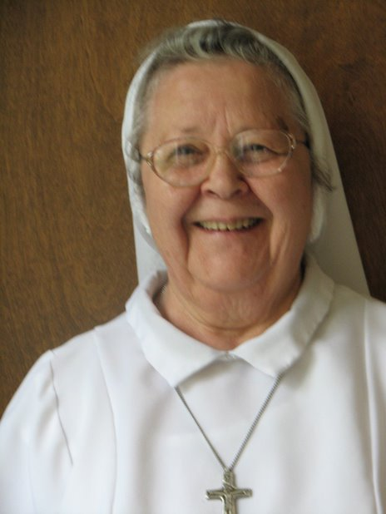
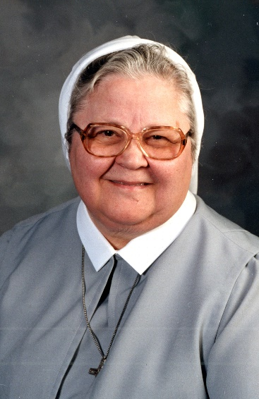
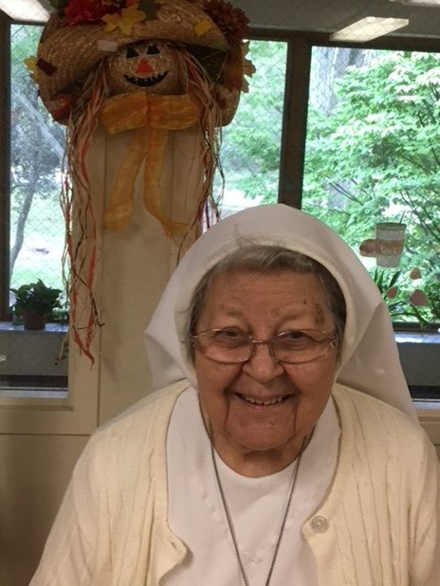
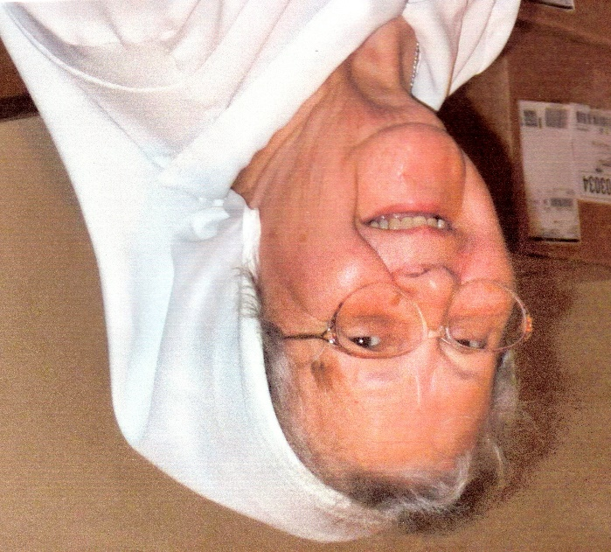
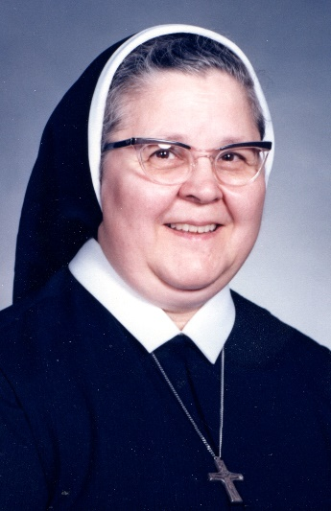
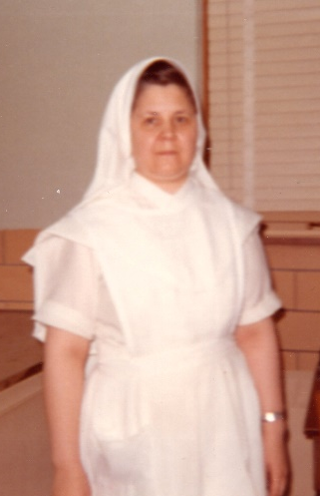
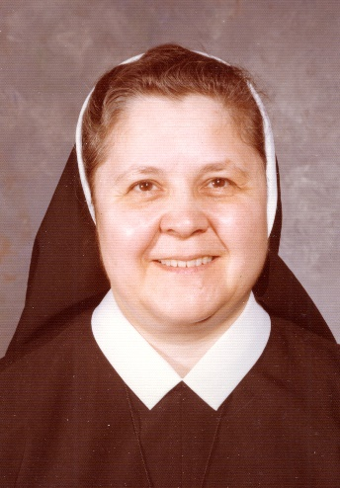
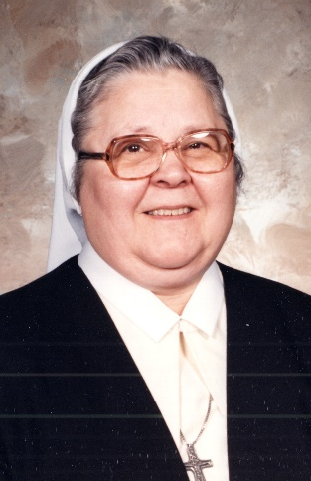
Over the Years
Visiting with Mom and Dad

Slide 17
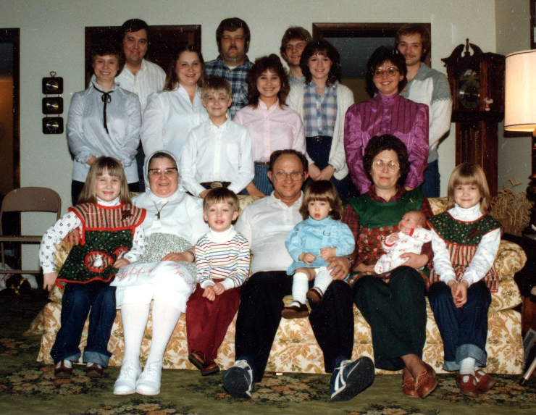
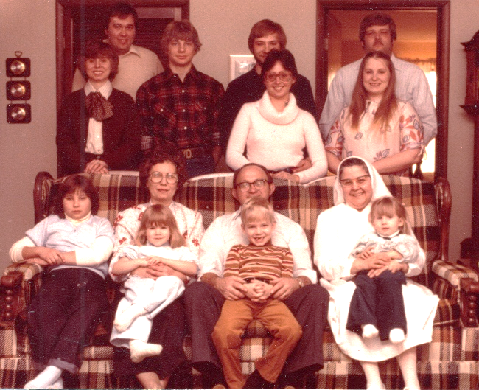
Christmas
1980
1984

Slide 18
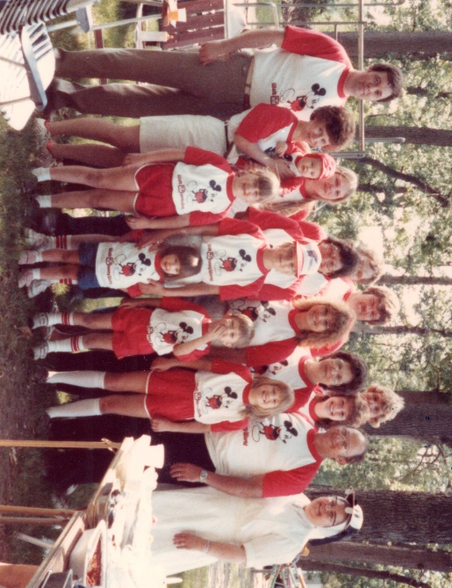
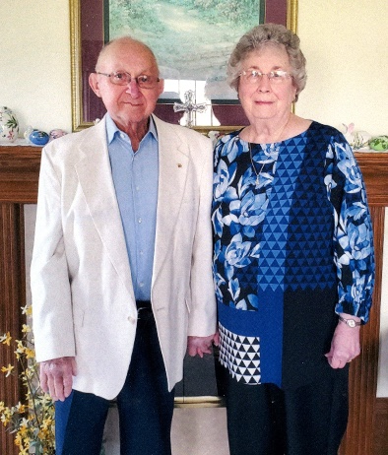
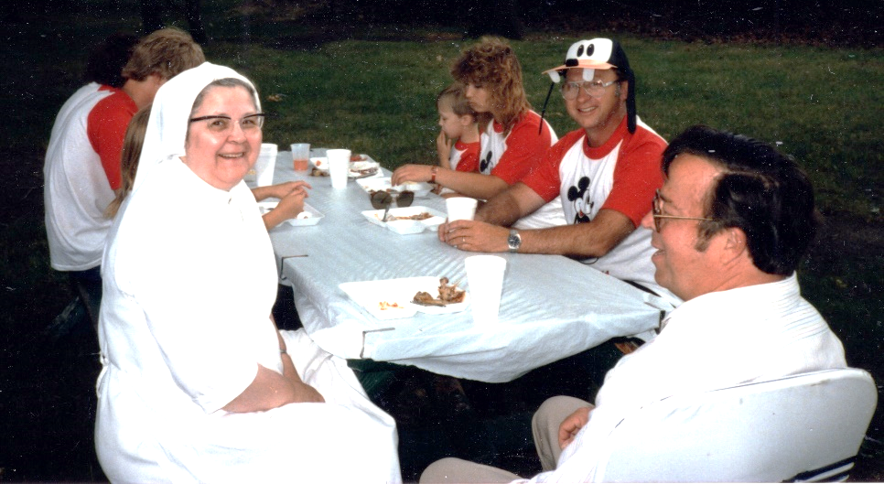
Bob and Marge
with
Children and
Grandchildren
Family Fun

Slide 19
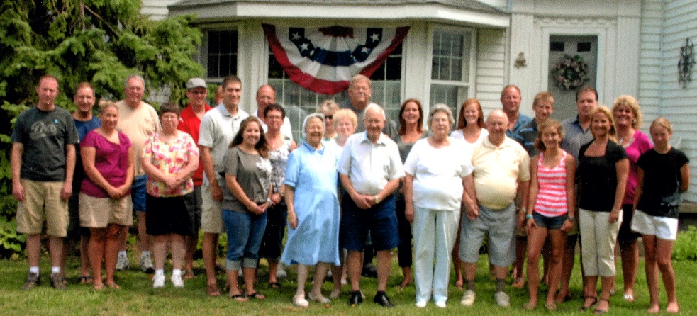
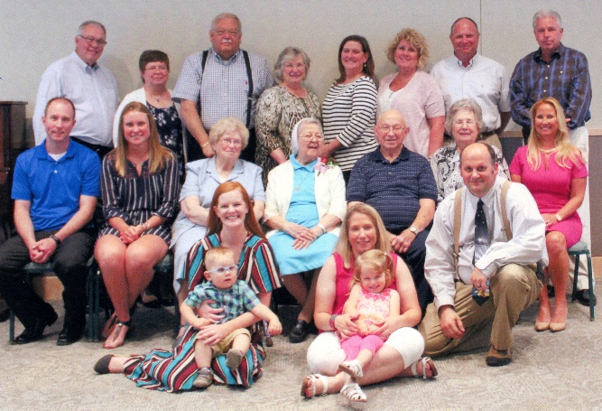
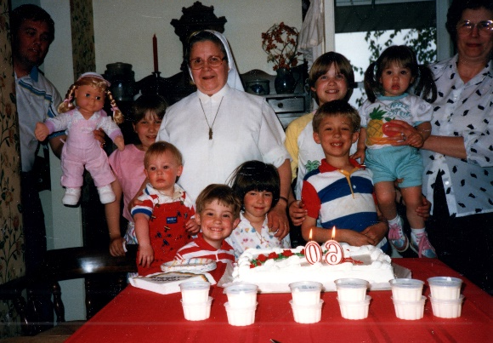
Jubilee
Century Farm Celebration 2012
Surprise 60th Birthday Party!

Slide 20
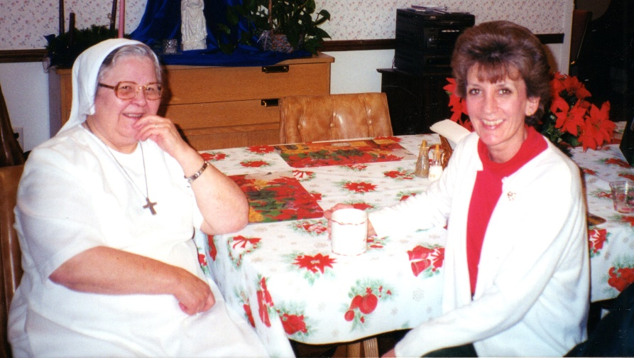
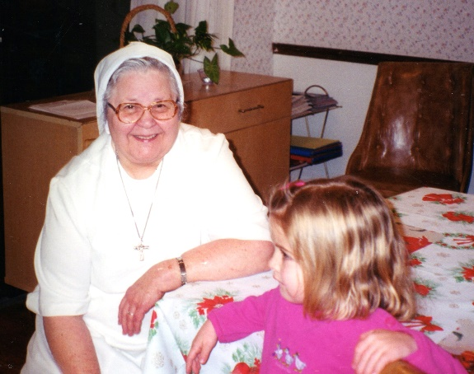
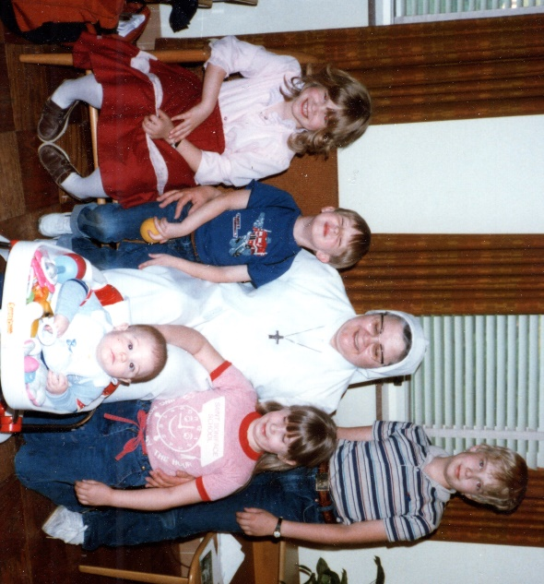
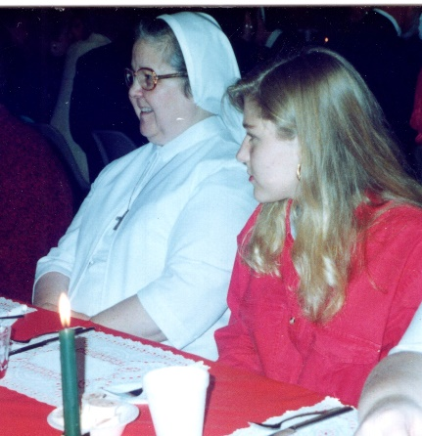
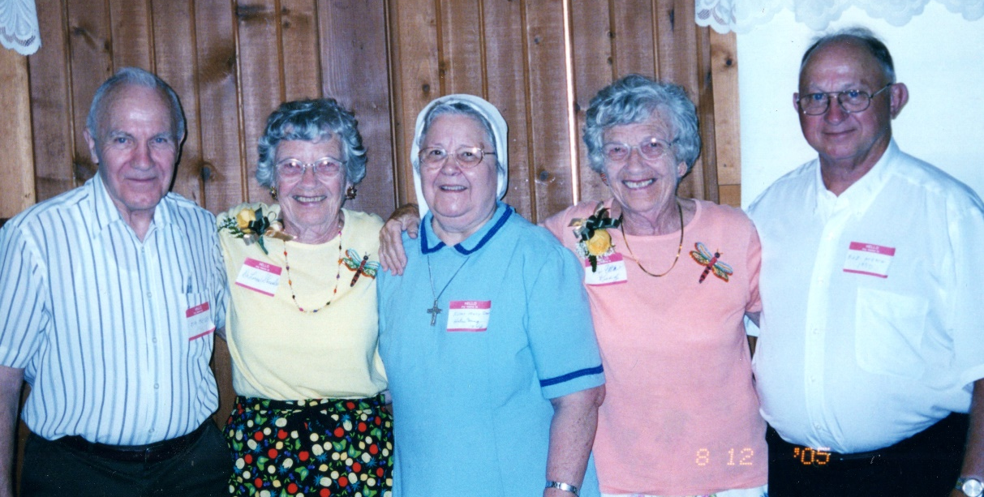
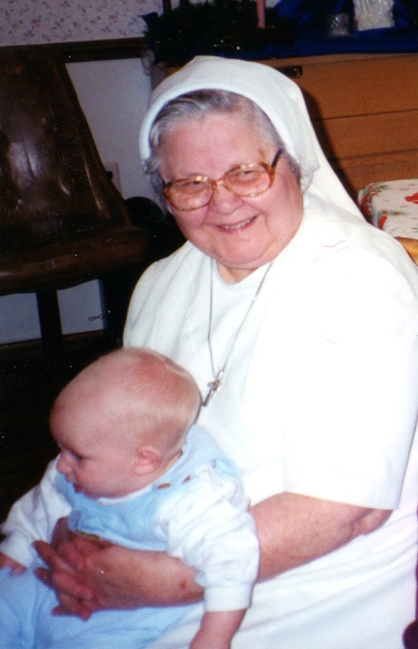
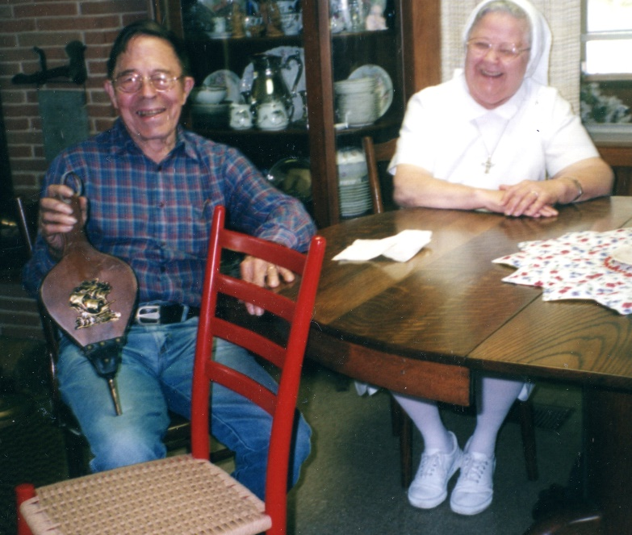
More Memories

Slide 21
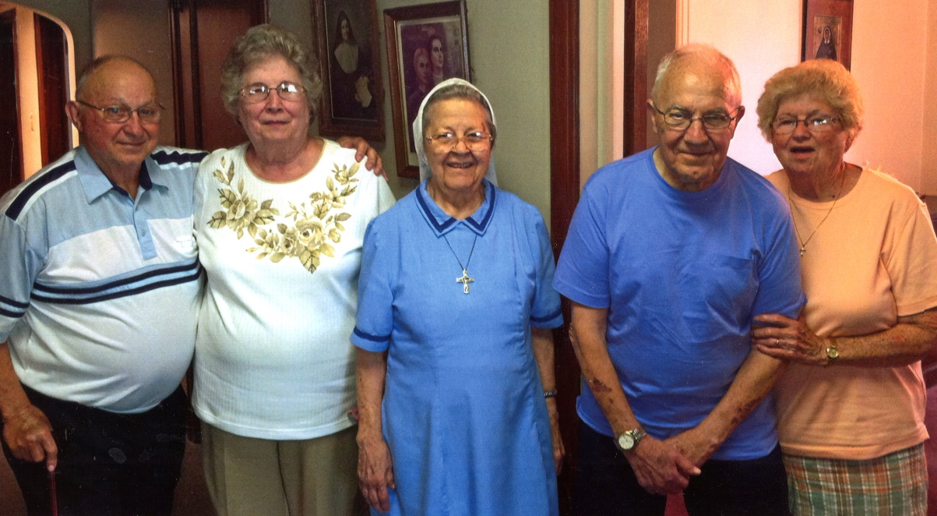
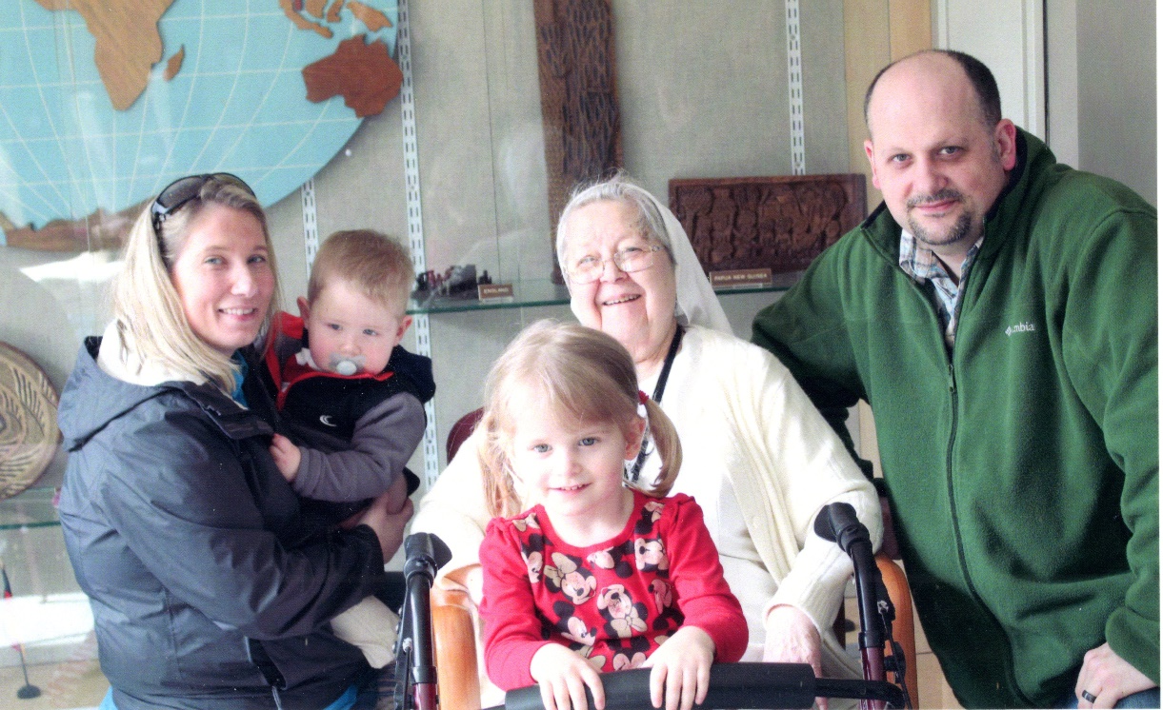

Slide 22
World Traveler 1991
In 1991 Sister Mary Damian had the opportunity to travel to Rome where she was to attend the beatification of Father Damian, the “Saint of Molokai”
Her disappointment was expressed in her notes: “The beatification did not take place because the Pope was in the hospital with a broken leg.” Father Damian was beatified in 1995 and raised to sainthood in 2009
Sister had this picture of Father Damian taken in 1889 just months before his death

Slide 23
St. Jude Parish Fort Wayne
1991 - 2015

Slide 24
Sister
made
multiple sets of these two dolls!

Slide 25
Woodhaven Years at the SND Center
Whitehouse Ohio

Slide 26
Our Fun Loving Sister!

Slide 28
Go in Peace, Sister Mary Damian!
We will miss you but
you will live forever
in our hearts!

